Slide 1




Let’s Go Fetch Susan’s Doghouse Launch Plan
Analyse the Strategies Eventbrite used.
Consider the Challenges Susan’s Doghouse faces.
Design an action plan for Susan.
Q1. What strategies did Eventbrite use
in order to launch online marketplaces ?
Q2. Which side is more difficult to obtain ?
Which challenges do you expect for Doghouse going forward ?
Q3. Design an action plan that will help Susan successfully launch into the market.
Group 1, Members: Kai Ren, PeiHua Ji, JunWen Luo, FeiFan Xu, Lei Cheng, Chang Li
Mar 25th, 2025

Slide 2


Q1. What strategies did Eventbrite use ?
1. Vertical focusing
Early integration with Silicon Valley technology and conference activities.
Based on: "Tech mixers and conferences became the core use case" .
3. Viral Loops
Participants → Event Creators → New Participants.
Mechanism: Free conversion rate 17%.
2. Free Engine
Free Events → SEO drives growth.
Stats: Free events contribute 34% of supply side users.
4. Select high-quality creators
Ticket sales priority show.
Based on: "Algorithm prioritized high-selling events”.
The free level is the start lever
The viral cycle is central to growth
Growth flywheel
Content Marketing → Blogs/whitepapers → SEO traffic
Brand cooperation → Bravo TV → Credibility enhancement
Founder Participation → CEO delivery room reply customer service

Slide 3
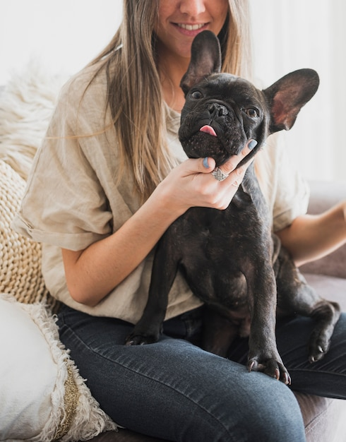
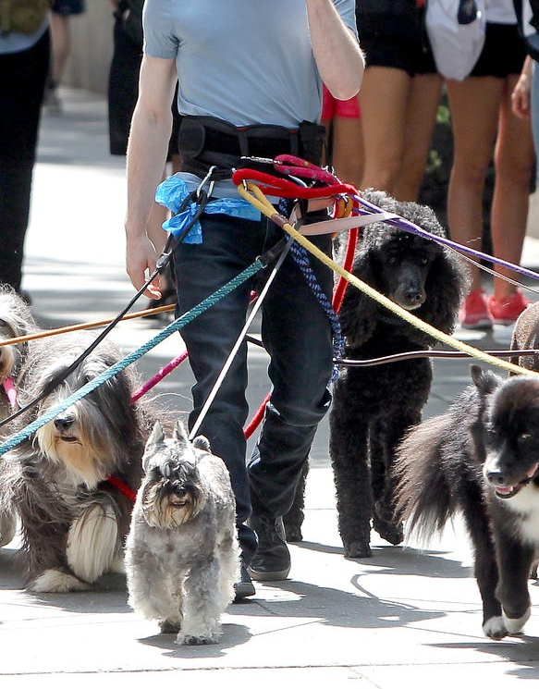
How does Susan’s Doghouse Work ?
Initiate Orders
Split Orders
Service Consumer
Dog Owner
Make Deals
Earn Profits
Service Provider
Dog Walker
Pay Fee $
Get Money $
Consumers are dog owners:
Love dogs.
Lack the time to walk dogs.
They need others to help.
But they are WORRING about:
Reliability of dog walkers.
Keeping the dog safe.
Timing is right.
Location is suitable.
Providers are dog walkers:
Have time.
Love dogs.
Master the basics.
Want to make money.
Doghouse Order
Time: 17:00 pm, 2025.3.27
Location: PHBS
Dog Breed: Samoyed
Dog Age: 2.5 years old
Duration: 1 hour
The platform uses algorithms for matching and splitting order.
Meet the Dog Walking Help demand and make it safer and standardized.

Slide 4
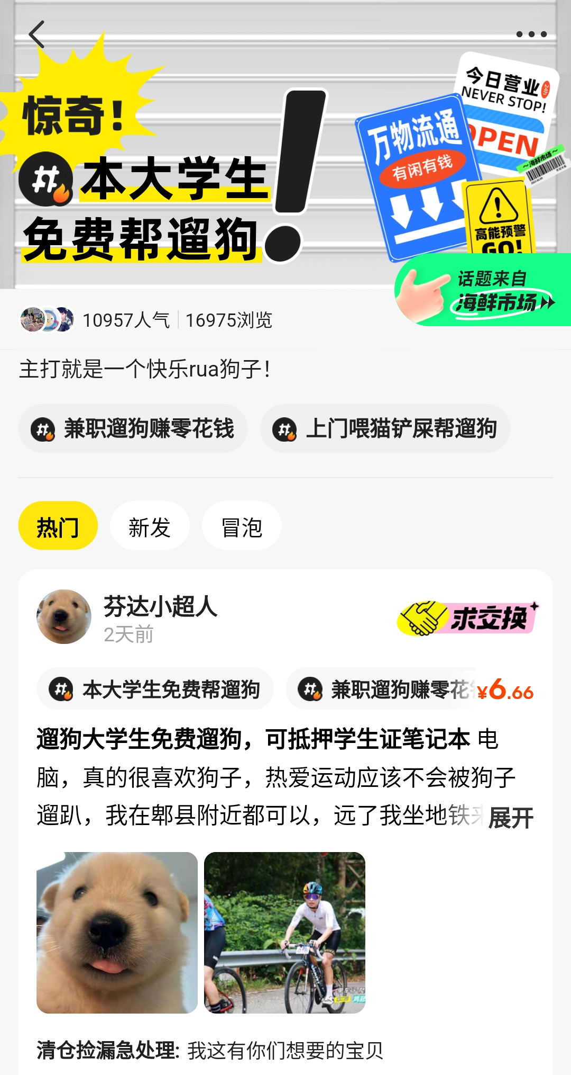



Q2. Side more Difficult to Obtain & Challenges ?
Dog Owner
Dog Walker
Difficult to accurately locate
the target audience.
Network effect is low(initial stage)
Preference: hobby (may有狗瘾)
Wide group: college students
Low cost: low skill and experience requirements
Platform Challenges
Qualification of dog walkers
Handling of Emergencies
(Car accidents, illnesses, etc)
Profit Model
Short term rapid matching
Competition from others
(Low entry threshold)
.
Difficult to build trust.
Qualification review ?
Quality of service ?
Evaluation and Complaints ?
Data on dog walking service on Xianyu platform. (2023.06)
supply ＞＞ demand
(105700) （27400）
The dog owner is more difficult to obtain!
Platform Challenges

Slide 5
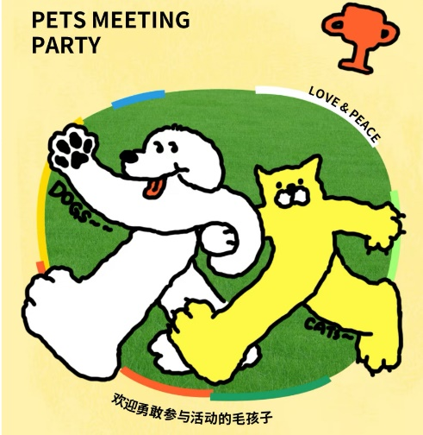
Q3. Action plan for Susan
Initiation Phase
Step1. Obtain Dog Walker
Key point: Qualification review
Step2. Obtain Dog Owner
Key point: Gain Trust
Step3. Obtain Dog Owner
Key point: Publicity
Sign a security contract
Upload ID card/student ID card
Psychometric questionnaire
Online interview
Establish a Transparent Scoring
Equip with GPS Tracking Dog Leashes
Accurately target potential users
Customized Feature Dog Leashes
Self-Media Promotion
Issue High-Value Coupons
Operational Phase
Connect Buyers and Sellers
Host a Dog Agility Competition
Organize offline competitions to attract dog owners to participate and dog lovers to spectate, which connecting both buyers and sellers.
Maintain Buyer Engagement
Build a Dog Owner Community
Regularly host dog owner meetups to facilitate interaction between dog owners and the platform.

